Slide 1
Consumer Choice Theory
Principles of Economics

Slide 2
What’s Ahead
Today– Consumer Theory
  Thursday – Labor Markets
  Next Week - Discrimination & Poverty, Private Info
April 23rd (One week)
  MindTap 5 (Ch. 21 and 18)
  Project Due
Exams back at the end of class

Slide 3
Project
Formal write up, prefer MLA, but consistency of any format is fine
  Due April 23rd
  Graphs, created in excel
  Hard copies in class
  Digital version uploaded to Moodle
    Due by 11:59PM on Monday, only one per group, must title each part with group members last names
  Sources on guidelines and MindTap

Slide 4
Project Topics
International Trade (Ch. 9)
Elasticity (Ch. 5)
Negative Externalities (Ch. 10)
Market Concentration (Ch. 17)
Demand and Supply (Ch. 4)
Cost Curves (Ch. 13)
Consumer Theory (Ch. 21) <- Today!

Slide 5
Motivation
We’ve spent a lot of time looking at firms, or supply. Now we look at consumers, or demand.
Consumer choice
  What explains the demand curve
  The effect of changes in prices and income
Today the theory, next class the application

Slide 6
Objectives
Draw a budget constraint in two dimensions
Explain how the optimal choice is determined
Demonstrate the income and substitution effects on a graph

Slide 7
Consumption Choices
  The choices you make as a buyer of goods and services are influenced by many factors, which economists summarize as
    Consumption possibilities
    Preferences
  Consumption possibilities are all the things that a consumer can afford to buy.

Slide 8
Utility
Satisfaction or pleasure from consuming a good, or bundles of goods
Subjective, different for different people
Difficult to quantify, imaginary units called ‘utils’ for convenience

Slide 9
Utility
In terms of preferences, we assume people want as many utils as possible.
  They prefer bundles that give them more utility
  Ua = 50 Ub=75 Uc=60

Slide 10
Utility
Total Utility
  Amount of satisfaction from consuming some specific quantity
Marginal utility
  Extra satisfaction from consuming one more unit
  Ex. Newspapers
Law of diminishing marginal utility
  Utility declines as a consumer acquires additional units of a good.

Slide 11
The Budget Constraint
Money is a scarce resource
  If you want more of something
  You must sacrifice other choices
The budget constraint captures that tradeoff
  Shows what a consumer can afford
  Given the consumer’s income and a set of prices

Slide 12
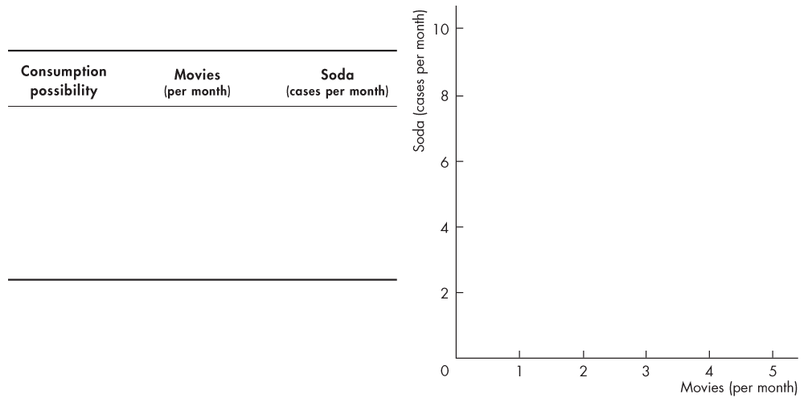
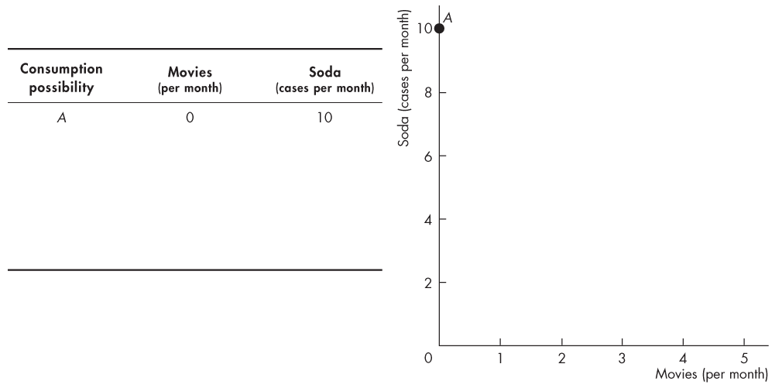
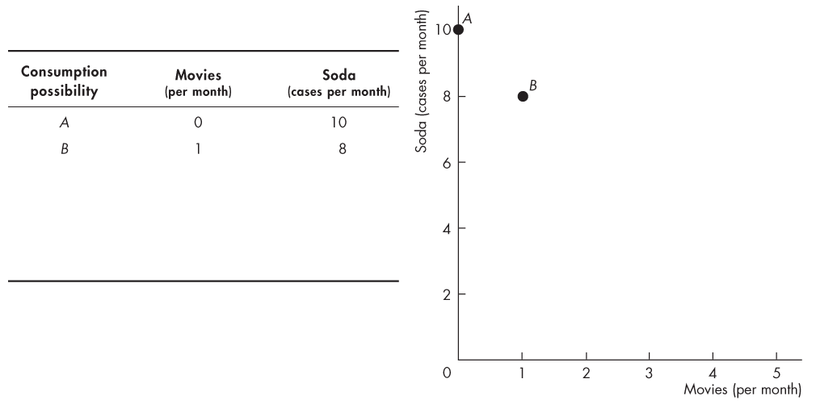
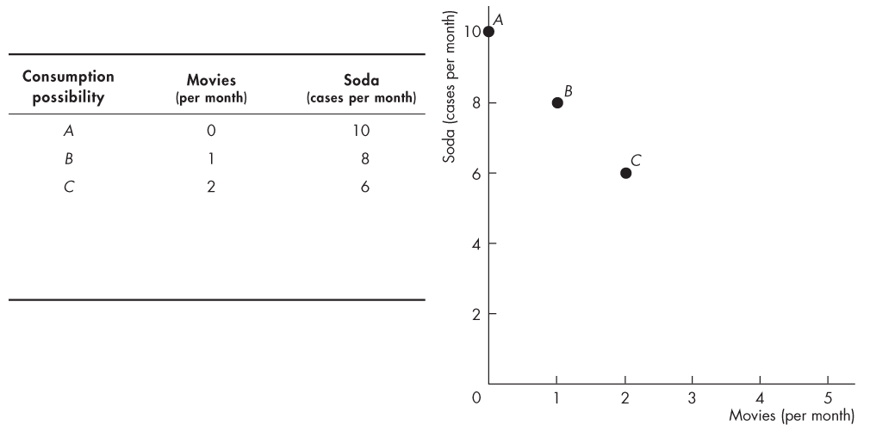
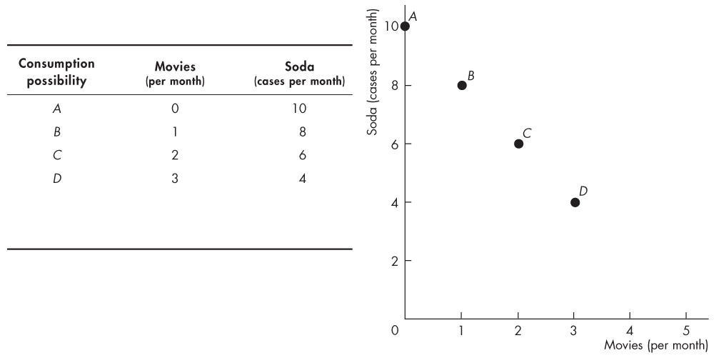
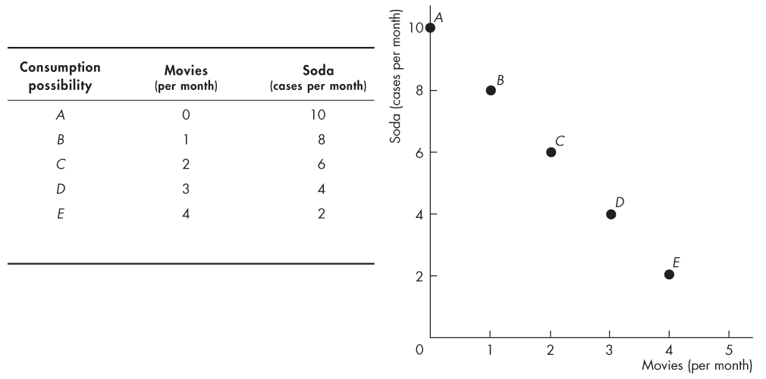
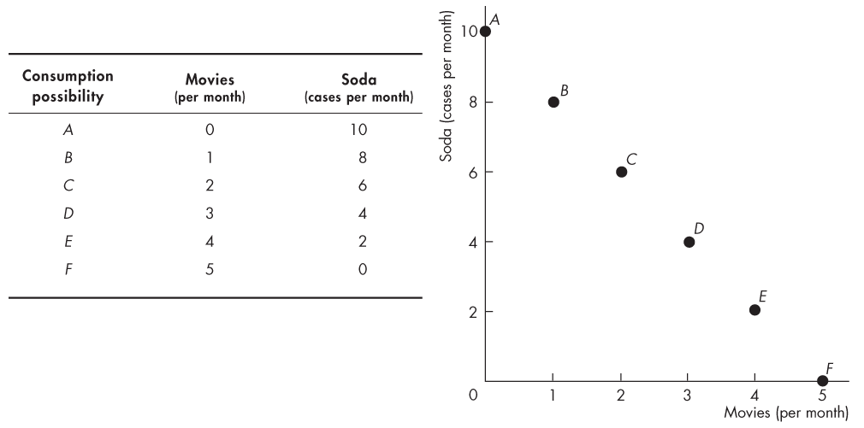
Consumption Choices
Lisa has $40 to spend, the price of a movie is $8 and the price of soda is $4 a case.

Slide 13
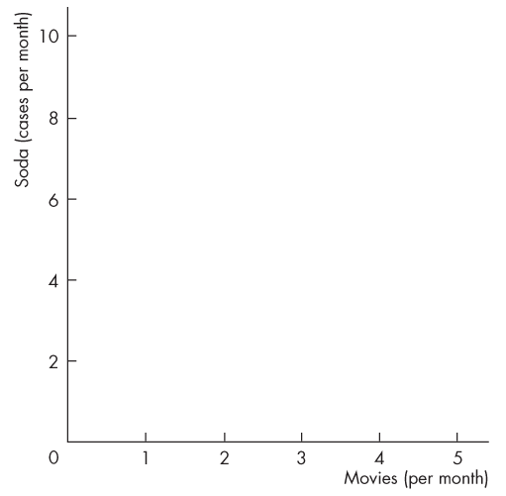
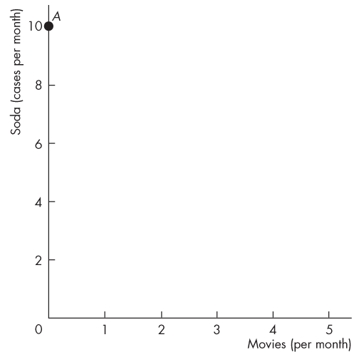
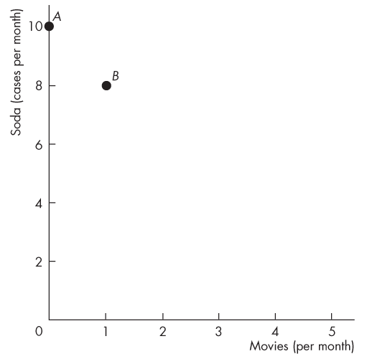
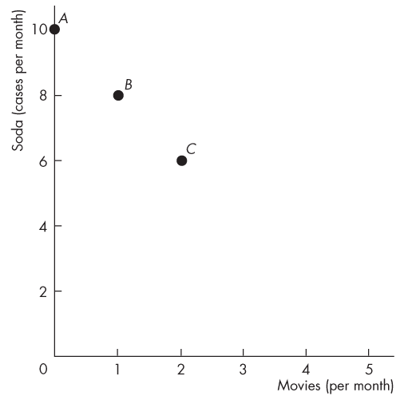
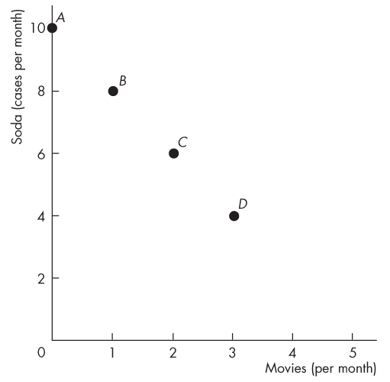
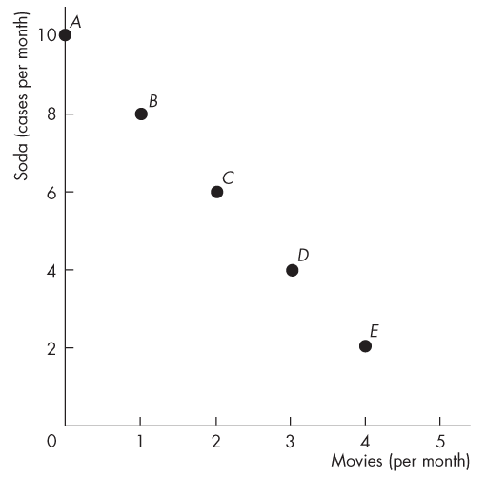
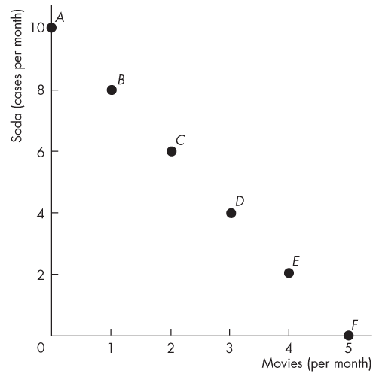
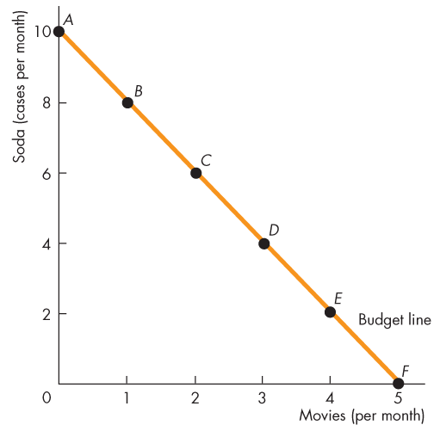
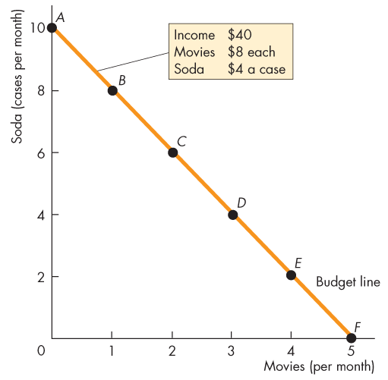
Consumption Choices
Lisa can afford any of the combinations at the points A to F.
Some goods are indivisible and must be bought in whole units at the points marked.
Other goods are divisible goods and can be bought in any quantity.
The line through points A to F is Lisa’s budget line.

Slide 14
Budget Constraint
  Budget Constraint (line)
    The set of all combinations of goods and services that a consumer can purchase when spending all of their available income.
      Fixed, limited amount of income consumers have to spend
  For simplicity, assume only 2 goods
Notes:
The budget line is like a restaurant menu. This example has been well received: Emphasize that the consumer’s budget line is like a menu showing what affordable combinations of food and drink are available to the consumer. Ask them to compare the relative prices between two goods: food and drink and depict the affordable combinations a diner can purchase with a set income.

Slide 15
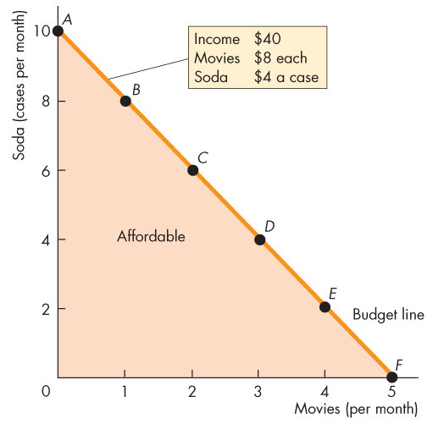
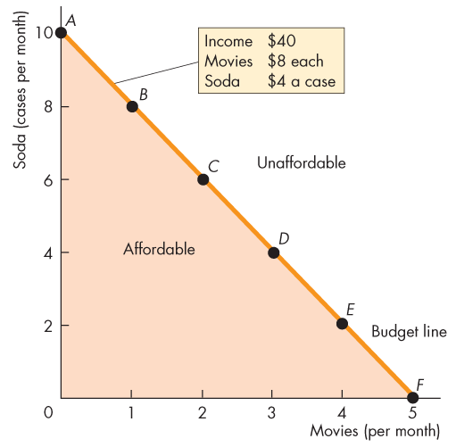
Consumption Choices
  The budget line is a constraint on Lisa’s consumption choices.
  Lisa can afford any point on her budget line or inside it.
  Lisa cannot afford any point outside her budget line.

Slide 16
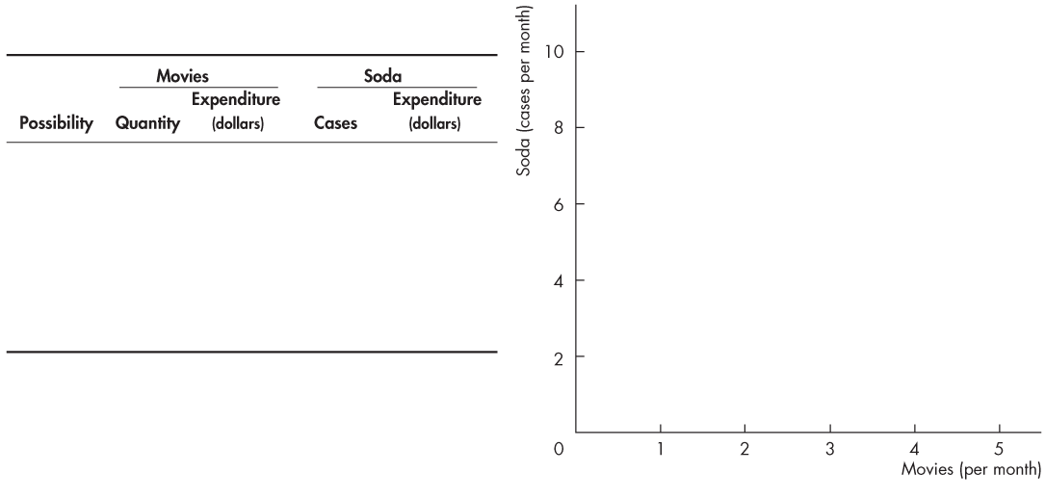
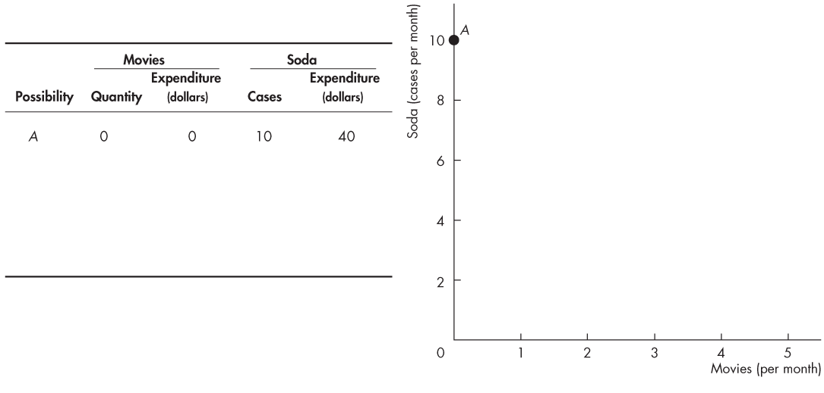
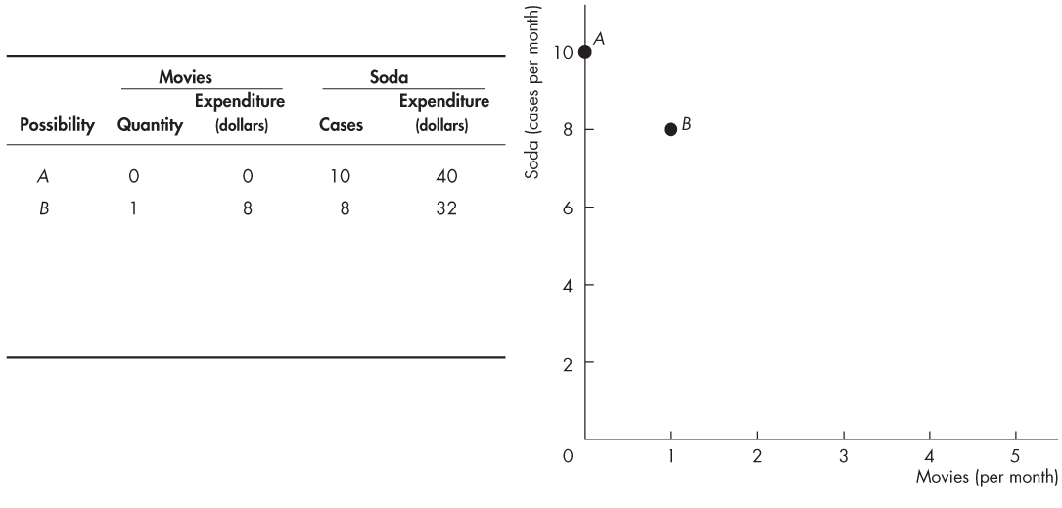
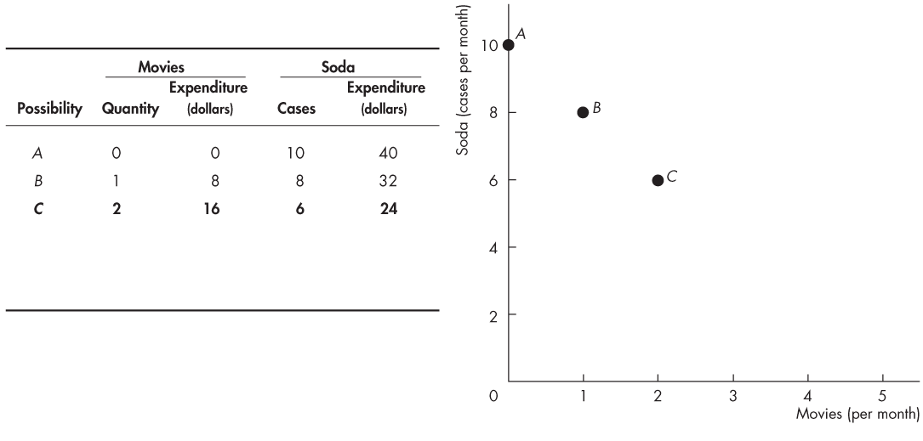
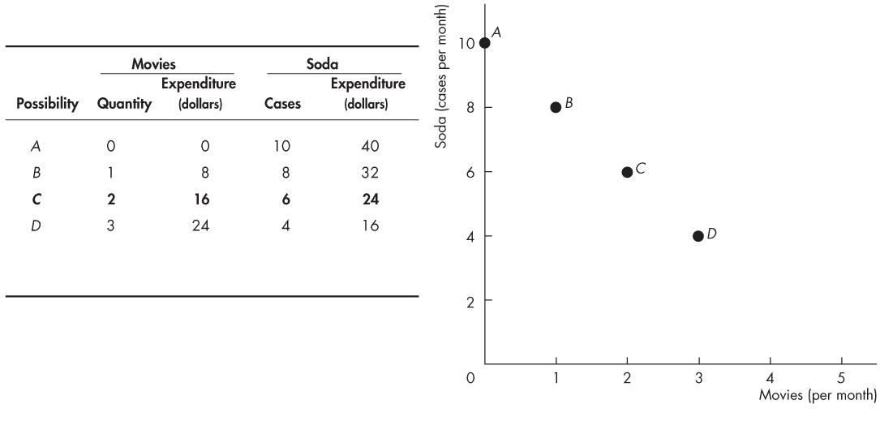
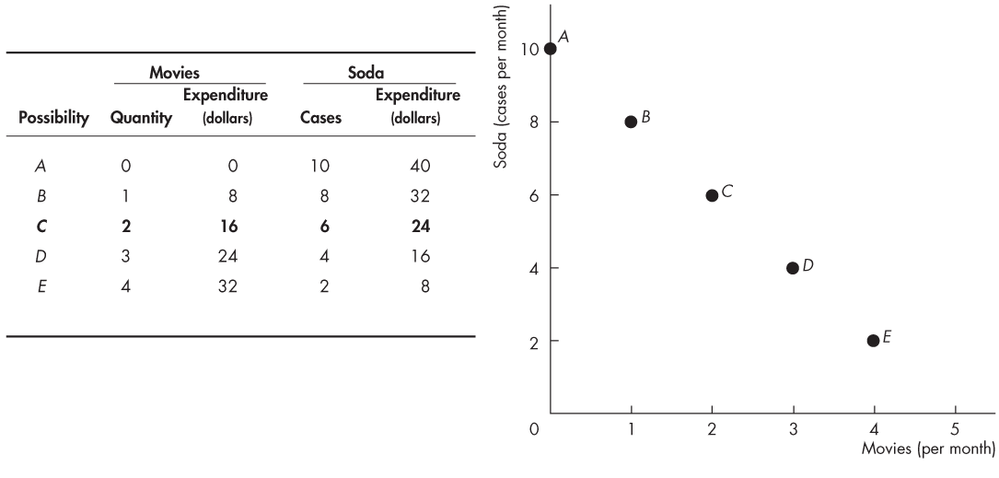

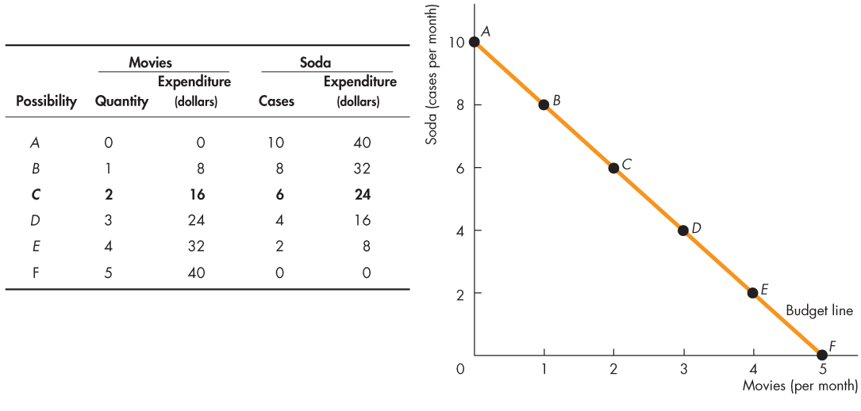
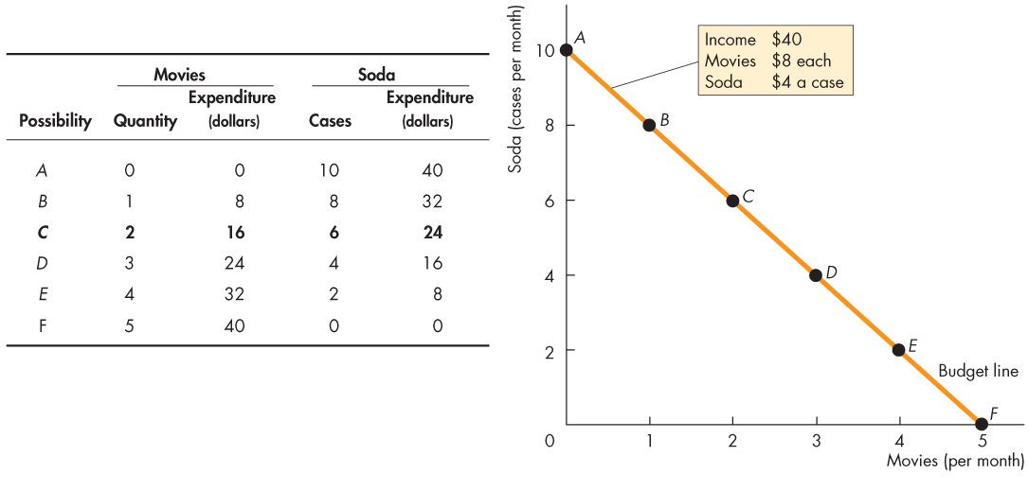
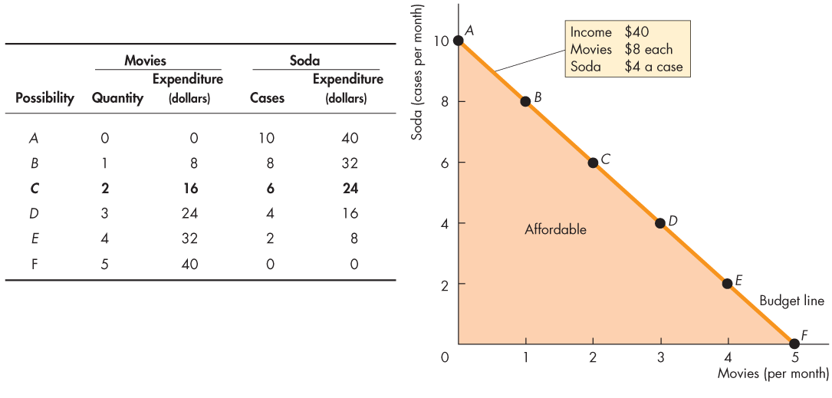
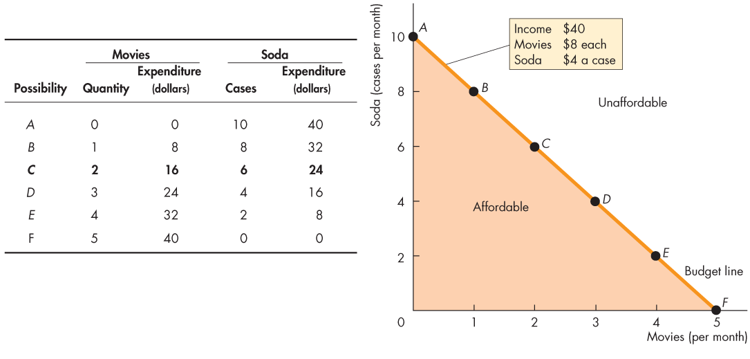

Slide 17

Budget Constraint
$$Income=Expenditure$$
$I=P_{Y}Y + P_{X}$X
I is income
P_{Y} is the price of good Y
Y is the quantity purchased of good Y
P_{X} is the price of good X
X is the quantity purchased of good X

Slide 18
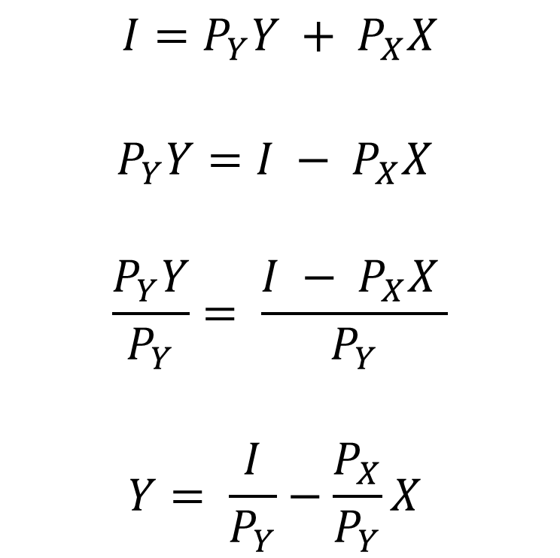
Budget Constraint
$$I=P_{Y}Y + P_{X}X$$
$$P_{Y}Y=I − P_{X}X$$
$$\frac{P_{Y}Y}{P_{Y}}= \frac{{I − P}_{X}X }{P_{Y}}$$
$$Y= \frac{I}{P_{Y}}−\frac{P_{X}}{P_{Y}}X$$
Algebraic manipulation shows us how to graph this budget line
We solve for Y
The first term is the intercept
The second term is the slope of the budget line
  It is the ratio of the two prices and tells us the rate at which consumers can trade one good for the other. OC
Divide both sides by P_{y} to isolate Y

Slide 19
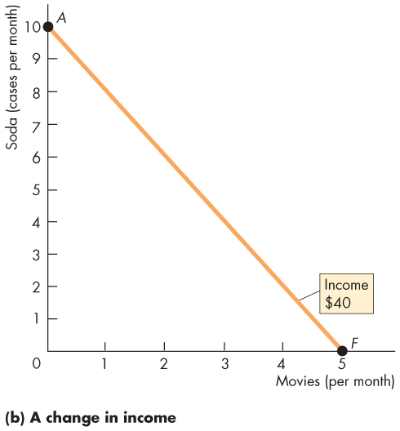
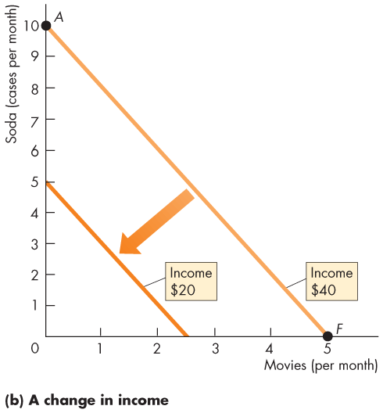
A Decrease in Income
A fall in income shifts the budget constraint down
  Consumption possibilities shrunk
The slope of the budget constraint is the same as before because there is no change in prices

Slide 20
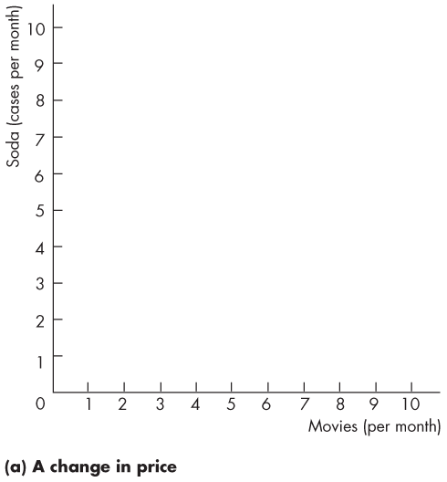
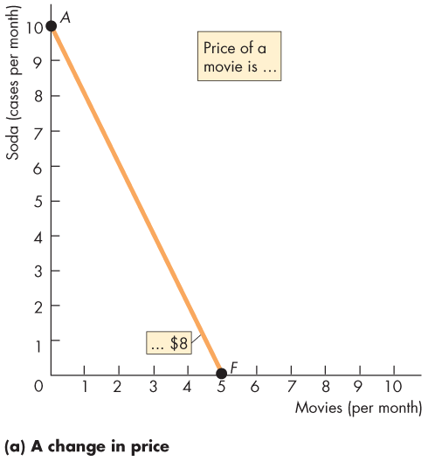
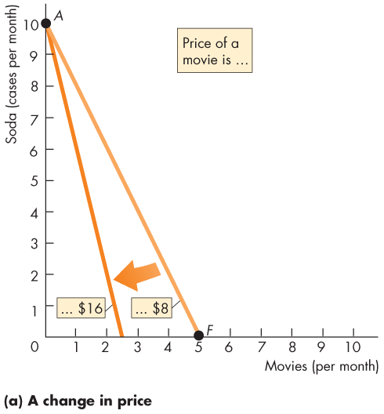
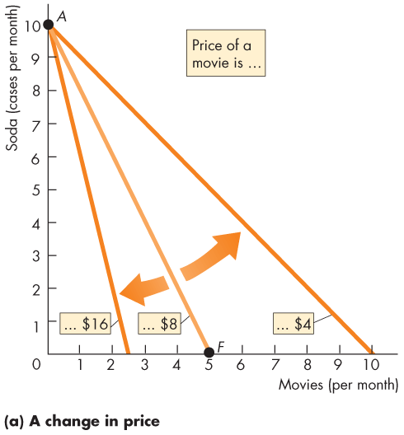
A Change in Price
  A change in the price of the good on the x-axis changes the slope of the budget line.
  We see a rotation of the budget line after a change in the relative price of movies.

Slide 21
Preferences
Preferences
    Each consumer has preferences for certain things and has an idea of how much satisfaction they get from consuming them
  We show preferences with indifference curves

Slide 22
Indifference Curve
Good Y
It illustrates a consumer’s preference among consumption bundles
Connects consumption bundles that give the consumer the same level of satisfaction
C
I₂
B
A
I₁
Good X

Slide 23
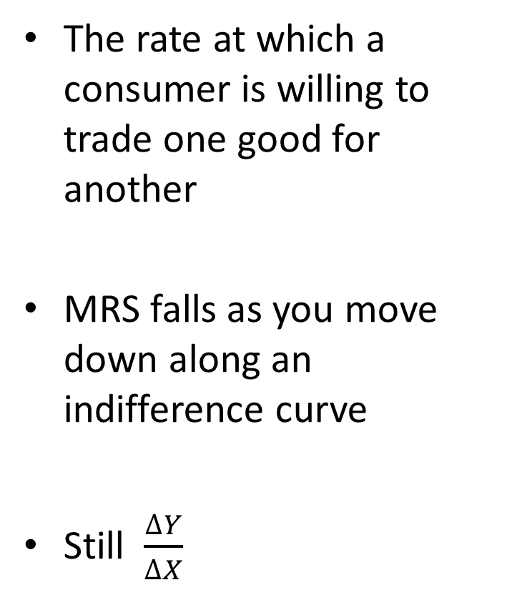
The Marginal Rate of Substitution
Good Y
The rate at which a consumer is willing to trade one good for another
MRS falls as you move down along an indifference curve
Still $\frac{∆Y}{∆X}$
MRS = slope of the indifference curve
I₁
Good X

Slide 24
The Marginal Rate of Substitution
  A diminishing marginal rate of substitution is the key assumption of consumer theory.
  It is a general tendency for a person to be willing to give up less of good y to get one more unit of good x, while at the same time remaining indifferent as the quantity of good x increases.

Slide 25
4 Properties of Indifference Curves
Good Y
Indifference curves are downward-sloping
If the quantity of
one good is reduced, the quantity of the other good must increase
B
A
I₁
Good X

Slide 26
4 Properties of Indifference Curves
Good Y
Higher indifference curves are preferred to lower ones
Every bundle on I₂ is preferred to every bundle on I₁
More is better
C
I₂
B
A
I₁
Good X

Slide 27
4 Properties of Indifference Curves
Good Y
Indifference curves cannot cross
If they did, the order in preferences would be lost:
A is as preferred as B
B is preferred to C
But C is as preferred as A
B
C
I₂
A
I₁
Good X

Slide 28
4 Properties of Indifference Curves
Good Y
Indifference curves are bowed inward
People are more willing to trade away goods that they have in abundance
People are less willing to trade away goods of which they have little
I₁
Good X

Slide 29
Extreme cases
Perfect Substitutes
Perfect Complements
Nickels
Left Shoes
Right angle indifference curves
MRS is constant
7
I₂
5
I₁
I₁
I₂
I₃
Dimes
5
Right Shoes

Slide 30
Less Extreme Cases
Close Substitutes
Close Complements
Pepsi
Hot dog Buns
Indifference curves for close substitutes are not very bowed
Indifference curves for
close complements are very bowed
Coke
Hot dogs

Slide 31
Indifference Curves & Utility
An indifference curve shows us all the combinations of goods that give the consumer the same level of satisfaction
  Make the consumer equally happy
Doesn’t this sound familiar?
Each indifference curve represents a certain ‘level’ or amount of utility gained from a set of combinations of goods

Slide 32

In-Class Activity
Income = $12
Price Popcorn = $3
Price Soda = $1.5
$$P= \frac{I}{P_{P}}−\frac{P_{S}}{P_{P}}S$$
$$P= \frac{12}{3}−\frac{1.5}{3}S$$
$$P=4−\frac{1}{2}S$$
Combination | Bags of Popcorn | Number of Sodas
A | 0 | 8
B | 1 | 6
C | 2 | 4
D | 3 | 2
E | 4 | 0

Slide 33
BC₁
Increased Income
Increase in Price of Soda

Slide 34
Optimization
What combination of goods generates the most satisfaction for the consumer while still staying on the budget line?
To maximize satisfaction while not spending more income than the consumer has, we find the combination of goods that allow a customer to reach the highest indifference curve while being on or inside the budget constraint

Slide 35
What the Consumer Chooses
Good Y
The optimum is the most preferred bundle out of all the bundles the consumer can afford
Optimization means buying the bundle that makes the consumer happiest, given his or her income
B
A
C
I₃
I₂
I₁
Good X

Slide 36
What the Consumer Chooses
Good Y
This happens when the choice
  Is on the budget line
  Is on the highest attainable indifference curve
  Has MRS equal to relative price (slope of budget line)
B
A
C
I₃
I₂
I₁
Good X

Slide 37
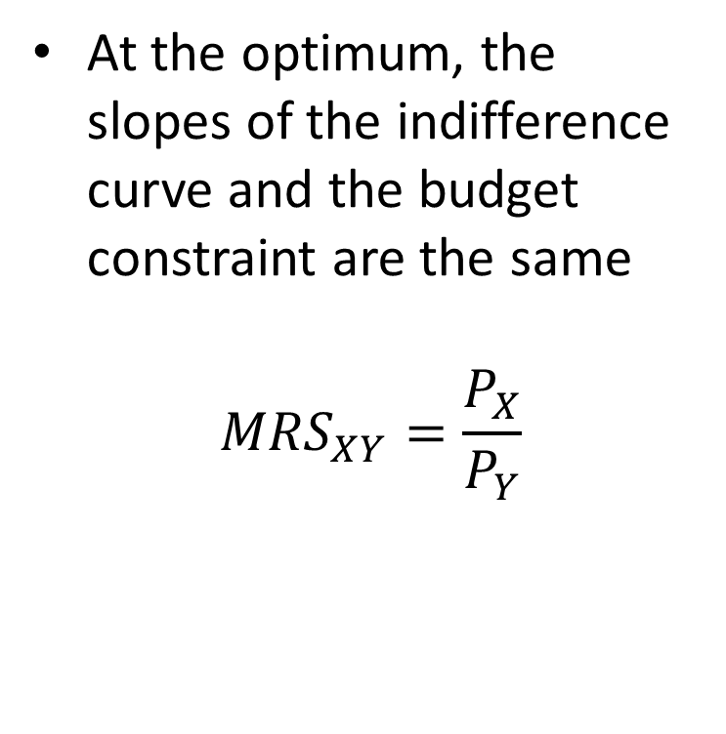


What the Consumer Chooses
Good Y
At the optimum, the slopes of the indifference curve and the budget constraint are the same
$${MRS}_{XY}=\frac{P_{X}}{P_{Y}}$$
Tangency between the indifference curve and the budget constraint
$$Q_{Y}$$
A
I₁
$$Q_{X}$$
Good X

Slide 38



The effects of an increase in income
Good Y
The budget constraint outward (same slope)
Relative prices don’t change
Consumption of both goods increases
  Normal goods
  more money, more goods
$${Q′}_{Y}$$
B
$$Q_{Y}$$
A
$$Q_{X}$$
$${Q′}_{X}$$
Good X

Slide 39


The case of an Inferior Good
Good Y
An increase in income shifts the budget constraint outward
But if one of the goods is inferior, the consumer will buy less of it
$$Q_{Y}$$
A
B
$${Q′}_{Y}$$
$$Q_{X}$$
$${Q′}_{X}$$
Good X

Slide 40
The Effects of a Price Change
Good Y
P_{X} falls
  the budget constraint rotates outward
  Different slope
The change from A to the new optimum is the result of two effects
A
New Optimum
Good X

Slide 41
The Income and Substitution Effects
A fall in the price of one good X has two effects:
Income effect
The lower price boosts the purchasing power
The consumer can buy more of good Y and good X
Substitution effect
The relative price changed too
Good Y is relatively more expensive than good X
The consumer will buy less of good Y and more of good X
Notice: The net effect on good Y is ambiguous

Slide 42
The Income and Substitution Effects
A fall in the price of one good X has two effects:
 | Income Effect | Substitution Effect | Total Effect
Good Y | ↑ | ↓ | ?
Good X | ↑ | ↑ | ↑
Income effect:
cheaper price = higher purchasing power
Total effect on good Y due to a fall in the price of X is ambiguous
Substitution effect:
change in relative prices = more consumption of the relatively cheaper good
Notes:
Income effect: The lower price boosts the purchasing power and the consumer can buy more of good 1 and good 2
Substitution effect: The relative price changed too, good 1 is relatively more expensive than good 2. The consumer will buy less of good 1 and more of good 2

Slide 43
Income & Substitution Effect*
Income
  Referred to as ‘buying more’ effect
  Represents the impact that a change in the price of a product has on a consumer’s real income
Substitution
  Represents the impact on the quantity bought due to a change in price when the consumer, hypothetically, remains indifferent between the original prices and the new ones

Slide 44
Income Effect & The Type of Good*
When the income and substitution effect move in the same direction, the good is a normal good.
When the income effect and substitution effect move in opposite directions, the good is an inferior good.
The SE > IE for both normal and inferior goods.
When the IE>SE for an inferior good, we have a Giffin Good

Slide 45
The Effects of a Price Change
Good Y
Substitution Effect
  Movement along the original indifference curve
  At point B: the slope of the indifference is the same as the new budget constraint
Substitution Effect
A
B
Good X
Substitution Effect

Slide 46
The Effects of a Price Change*
Good Y
Income Effect
  Movement to a higher indifference curve
  At point C: Tangency between the new budget constraint and a higher indifference curve
Income Effect
A
C
B
Good X
Income Effect

Slide 47
The Effects of a Price Change
Good Y
Good Y
  substitution effect negative
  income effect positive
  Net effect negative
Good X
  substitution effect positive
  income effect positive
  Net effect positive
A
C
B
Good X

Slide 48
Deriving the Demand Curve
The demand curve summarizes of the optimal decisions after a price change
The combined income and substitution effects shows the total change in the quantity demanded

Slide 49




Deriving the Demand Curve
Consumer’s Optimum
Demand Curve
Good Y
P_{X}
An decrease in the price of good 2
Increases the quantity demanded of good 2
A
A
C
C
$$Q_{A}$$
$$Q_{C}$$
Good X
$$Q_{A}$$
$$Q_{C}$$
Good X

Slide 50
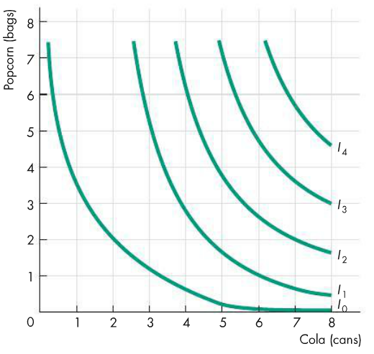
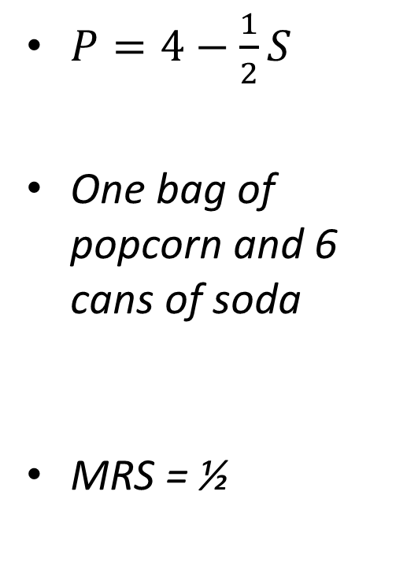
In Class Activity
$P=4−\frac{1}{2}S$
One bag of popcorn and 6 cans of soda
MRS = ½

Slide 51
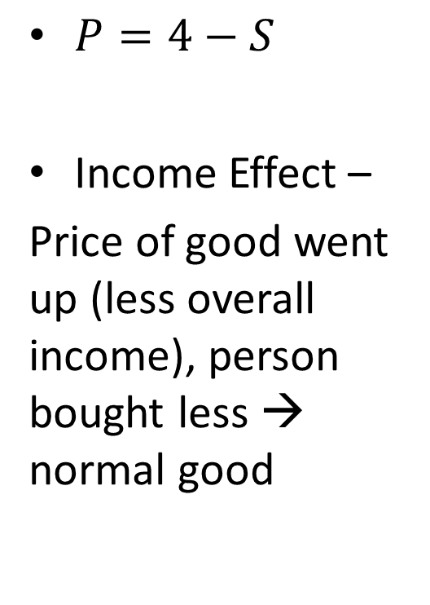
In Class Activity – Change in Soda
Our new slope against the old curve
$P=4−S$
Income Effect –
Price of good went up (less overall income), person bought less → normal good
IE
SE

Slide 52
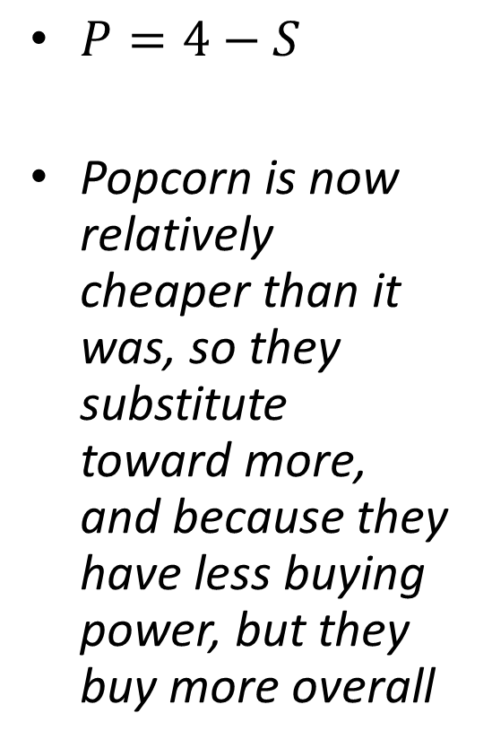
In Class Activity – Change in Popcorn
$P=4−S$
Popcorn is now relatively cheaper than it was, so they substitute toward more, and because they have less buying power, but they buy more overall
IE
SE

Slide 53
Giffen Good
A good for which an increase in price raises the Q_{d}
Two goods: Potatoes and meat
  Potatoes are an inferior good
P_{p} increases
  SE: buy less potatoes
  IE: buy more potatoes
If IE > SE, then potatoes Giffen good

Slide 54
Giffen Good
Quantity of
Potatoes
Initial budget
constraint
1. An increase in the price of potatoes rotates the budget constraint inward . . .
B
D
Optimum with high
price of potatoes
New
budget
constraint
2. . . . which increases potato consumption if potatoes are a Giffen good.
E
C
Optimum with low
price of potatoes
I₁
I₂
A
0
Quantity of Meat
In this example, when the price of potatoes rises, the consumer’s optimum shifts from point C to point E. In this case, the consumer responds to a higher price of potatoes by buying less meat and more potatoes.

Slide 55
Wage & Labor Supply
Budget Constraint
  Trade-off between consumption and leisure
  How an individual divides their time between working and leisure
  Relative price of an hour of leisure, is the amount of consumption they can buy with an hour’s wages

Slide 56
Wages & Labor Supply
Consumption
Assume an individual has 100 hours free in a week to either work or relax. When they work, they make $50 an hour.
$5,000
At the optimum,
the MRS between
leisure and consumption equals the wage.
Optimum
I₃
2,000
I₂
I₁
0
60
100
Hours of leisure

Slide 57
Wages and Labor Supply
Increase in wage on Optimum labor supply
  SE: Higher wages → Leisure more expensive, so work more
  IE: Higher wages → can work more and relax more
    Can choose more leisure, reduces Q Labor supplied

Slide 58
Wages and Labor Supply
For this person, SE > IE
So her labor supply increases with the wage
Consumption
Wage
BC₂
Labor supply
B
I₂
1. When the wage rises . . .
BC₁
A
I₁
0
0
Hours of Leisure
Hours of Labor
Supplied
2. . . . hours of leisure decrease . . .
3. . . . and hours of labor increase

Slide 59
Wages and Labor Supply
For this person, SE < IE
So his labor supply falls when the wage rises
Consumption
Wage
BC₂
Labor supply
1. When the wage rises . . .
I₂
I₁
BC₁
0
0
Hours of Leisure
Hours of Labor
Supplied
2. . . . hours of leisure increase . . .
3. . . . and hours of labor decrease

Slide 60
Savings vs Spending
Live for 2 periods
  P1: work and earn $100,000
  Consume = 100,000 – (amt saved)
  P2: retired, consumption = (amt saved)*interest
Interest Rate
  Determines the relative price of consumption when young in terms of consumption when old

Slide 61
Savings vs Spending
Consumption
when Old
Budget constraint shown is for 10% interest rate.
At the optimum,
the MRS between
current and future consumption equals the interest rate.
$110,000
Optimum
55,000
I₃
I₂
I₁
0
$50,000
100,000
Consumption when Young

Slide 62
Savings vs Spending
Increase in interest rates
  SE: current consumption more expensive relative to future consumption
  Current consumption falls, saving rises, future consumption increases
  IE: can afford more consumption in both periods
  Future savings decrease

Slide 63
Savings vs Spending
(a) Higher Interest Rate Raises Saving
(b) Higher Interest Rate Lowers Saving
Consumption
when
old
Consumption
when
old
BC₂
1. A higher interest rate rotates the budget constraint outward . . .
1. A higher interest rate rotates the budget constraint outward . . .
BC₂
2. . . . resulting in lower consumption when young and, thus, higher saving.
I₂
I₂
2. . . . resulting in higher consumption when young and, thus, lower saving.
I₁
BC₁
I₁
BC₁
0
0
Consumption when Young
Consumption when Young
In this case, SE > IE and saving rises
In this case, SE < IE and saving falls

Slide 64
IE & SE
What these examples have proven, is that depending on an individuals preferences, their outcomes will vary
  Some people are workaholic, while some people work the bare minimum.
  The IE and SE have varying impacts on individuals, and will ‘battle’ one another to get a result.
  An individuals preferences (indifference curve/utility) will dictate the winner

Slide 65
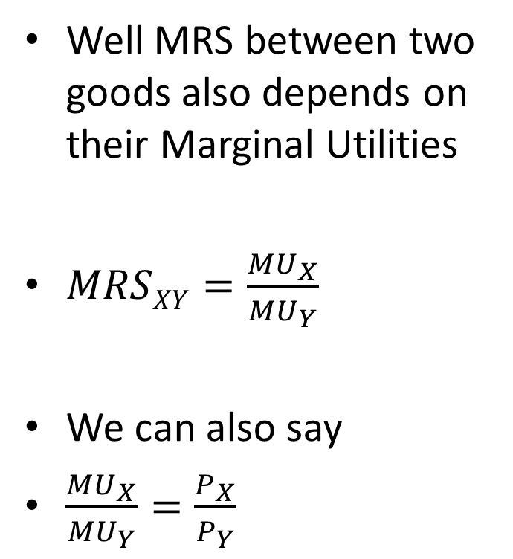
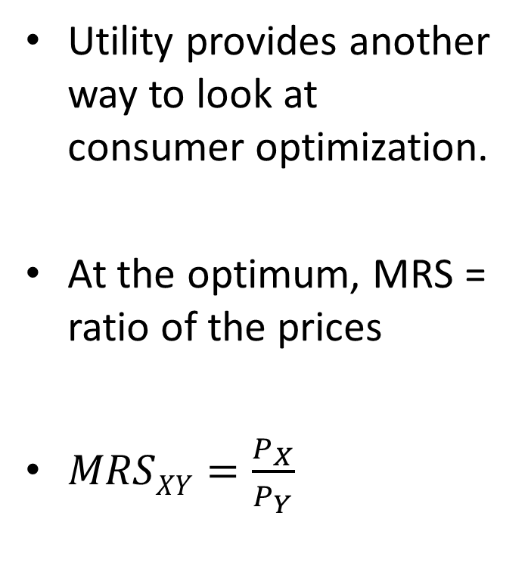
MRS & Utility
Utility provides another way to look at consumer optimization.
At the optimum, MRS = ratio of the prices
$MRSXY=\frac{P_{X}}{P_{Y}}$
Well MRS between two goods also depends on their Marginal Utilities
$MRSXY=\frac{{MU}_{X}}{{MU}_{Y}}$
We can also say
$\frac{{MU}_{X}}{{MU}_{Y}}=\frac{P_{X}}{P_{Y}}$

Slide 66
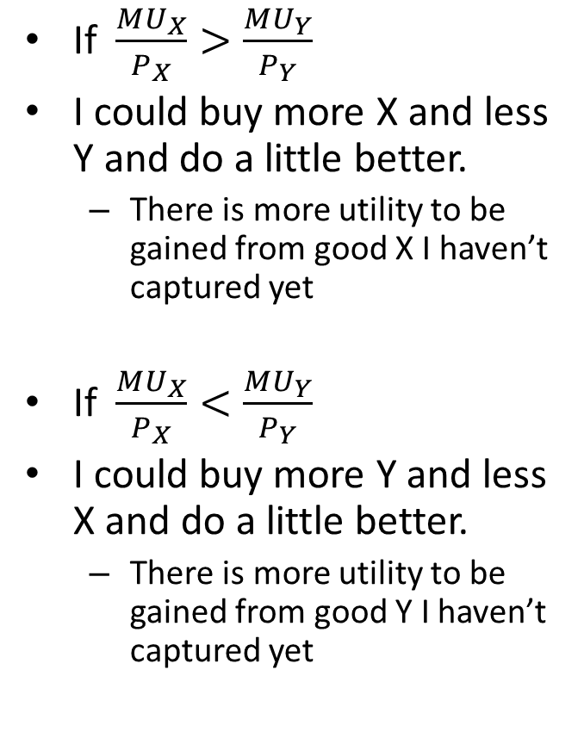
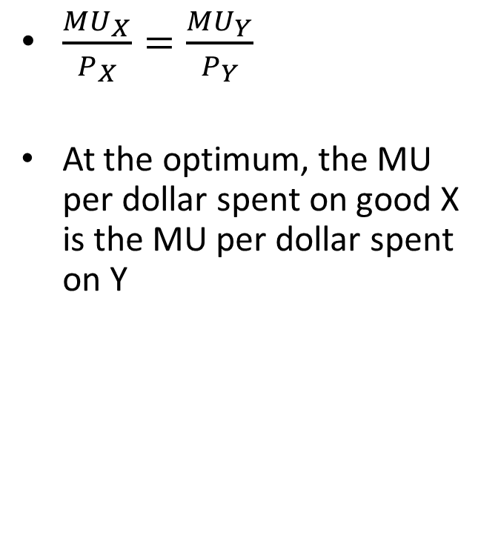
MRS & Utility
$\frac{{MU}_{X}}{P_{X}}=\frac{{MU}_{Y}}{P_{Y}}$
At the optimum, the MU per dollar spent on good X is the MU per dollar spent on Y
If $\frac{{MU}_{X}}{P_{X}}>\frac{{MU}_{Y}}{P_{Y}}$
I could buy more X and less Y and do a little better.
  There is more utility to be gained from good X I haven’t captured yet
If $\frac{{MU}_{X}}{P_{X}}<\frac{{MU}_{Y}}{P_{Y}}$
I could buy more Y and less X and do a little better.
  There is more utility to be gained from good Y I haven’t captured yet

Slide 67
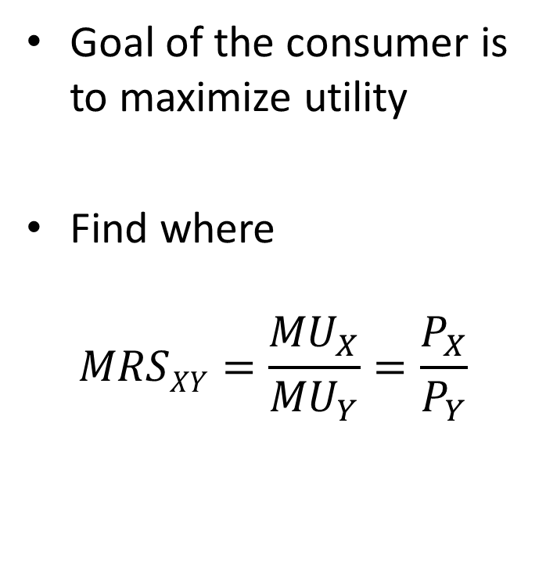
Two Sides of the Same Coin
Goal of the consumer is to maximize utility
Find where
$$MRSXY=\frac{{MU}_{X}}{{MU}_{Y}}=\frac{P_{X}}{P_{Y}}$$
Goal of consumer is to end up on the highest possible indifference curve
Find where indifference curve is tangent to budget constraint
The slope of the budget constraint
They are saying the same thing

Slide 68

You might say that you’re willing to pay only 99¢ for a song, but that’s not the answer of the average consumer.
And it is probably not really your answer either. It is also not what the answer would have been just a few years ago.
We can work out what people are willing to pay for a song by finding the demand curve for songs and then finding the consumer surplus.
To find the demand curve, we need to look at the prices and quantities in the market for songs.

Slide 69
In 2015, Americans spent $6.3 billion on all forms of recorded music, down from $14 billion in 2000.
But the combined quantity of discs and downloads bought increased from 1 billion in 2000 to 1.5 billion in 2015.
And the average price of a unit of recorded music fell from $14 to $4.28.
The average price fell because the mix of formats changed dramatically.
In 2000, we bought 900 million CDs; in 2015, we bought only 98 million CDs and downloaded 1.3 billion music files and paid 16 million streaming subscriptions.

Slide 70
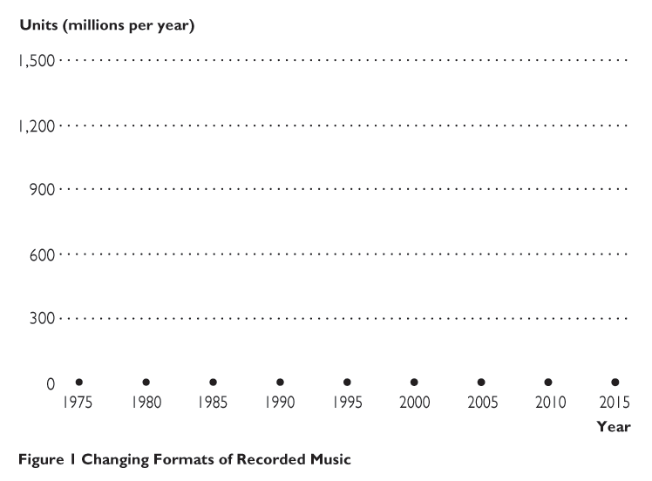
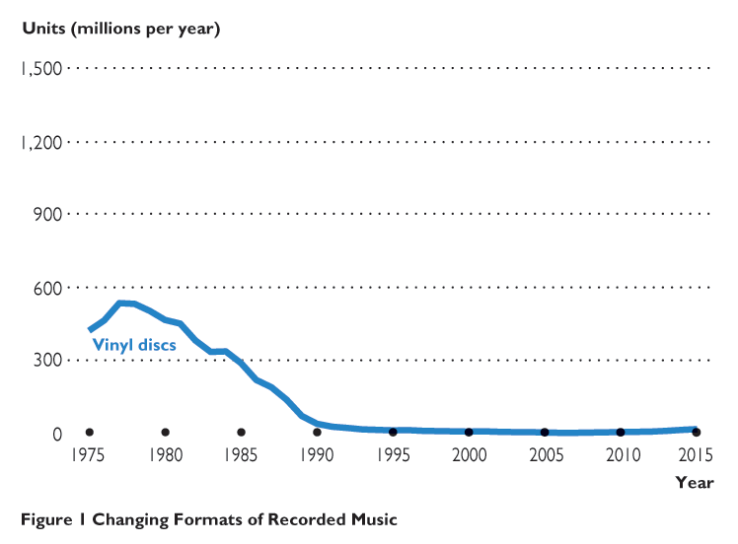



Figure 1 shows the longer history of the changing formats of recorded music.

Slide 71
The music that we buy isn’t just one good—it is several different goods.
We’ll distinguish singles from albums and focus on the demand for singles.
In 2000, we bought 100 million singles and paid an average price of $5.00.
In 2015, we downloaded 1,500 million singles files and paid an average price of $1.20 each.

Slide 72





Figure 2 shows the demand curve for singles.
In 2000, 100 million singles were bought at an average price of $5.00.
In 2015, 1,200 million singles were download at an average price of $1.20.
The green area shows the increase in consumer surplus, which is $2 billion or $1.40 per single.

Slide 73
The increase in consumer surplus of $1.40 per song is an estimate of how much more an average buyer would be willing to pay for an average song.
Paid subscriptions for streaming increase consumer surplus even more.
A streaming subscription is a fixed cost per month, so the average price of a song is the monthly subscription divided by the number of different songs played.
But the price of the marginal song is zero, so consumer surplus becomes the entire area under the demand curve at a zero price minus the fixed subscription cost.

Slide 74
Summary
The budget constraint shows the possible combinations of different goods a consumer can buy given an income and the prices of the goods
The slope of the budget constraint equals the relative price of the goods

Slide 75
Summary
The income effect:
  Change in consumption after a change in price
  It is represented by a jump to a different indifference curve
The substitution effect:
  Change in consumption after a price change
  Consumption favors the relatively cheaper good
  It is represented by a movement along the same indifference curve

Slide 76
Next Class
For next class
  Bring your computers, have them charged
  Read Chapter 18 – Factors of Production
Project due in 1 week!
MindTap due the same day

